Slide 1

PHYSICS LAB
( 20147)
Experiment No. 2
Basic Measurement I
A. Vernier Caliper
B. Micrometer Caliper

Slide 2
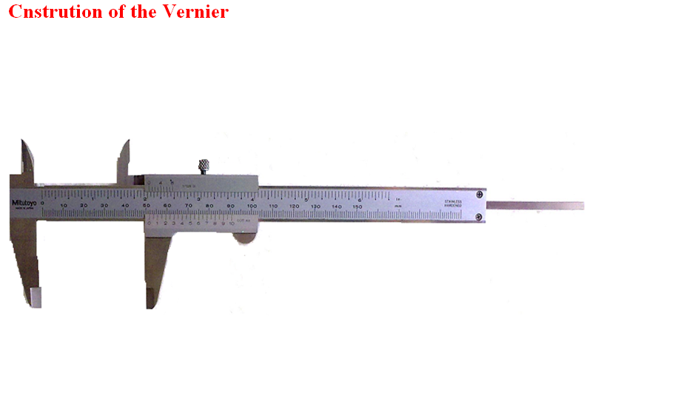
A . The vernier Caliper

Slide 3
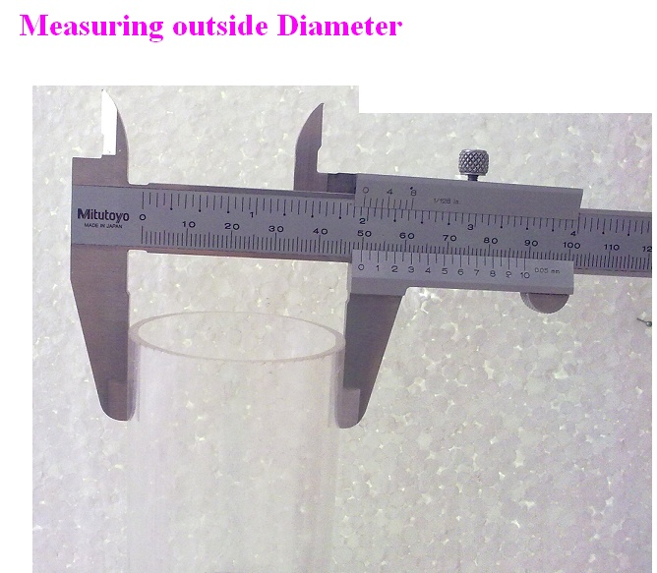
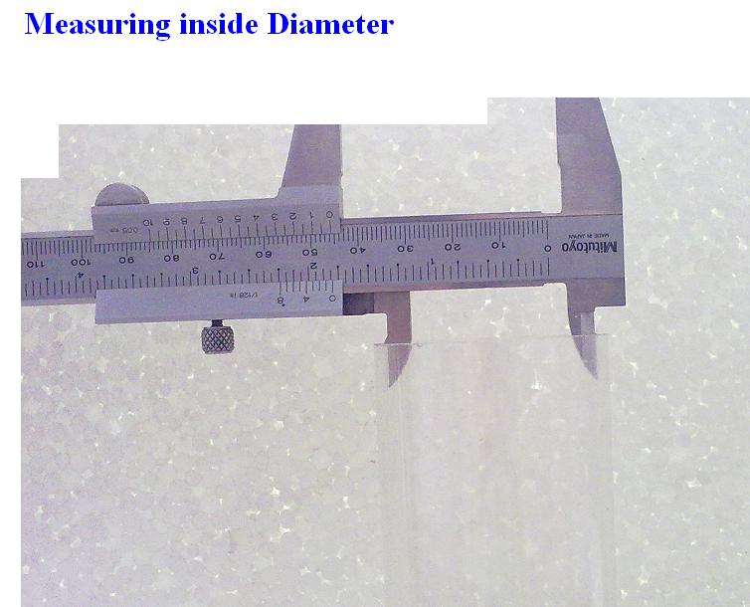
Using the Vernier caliper in measurement

Slide 4
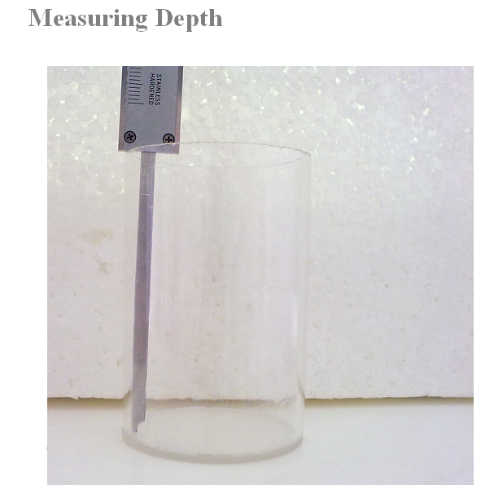

Slide 5
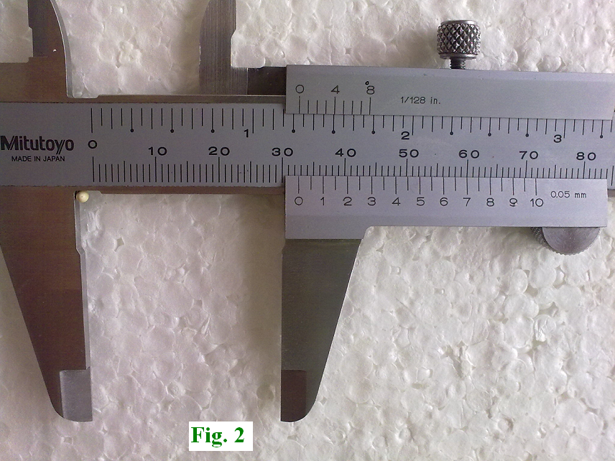
Example : What is the reading of the vernier in fig.2?
Position of the vernier zero.
It lies between 32 and 33 mm, we
take the smallest as main reading.
Main reading = 32 mm.
The two coincident lines.
We search for two lines in main scale and in Vernier scale that coincide. In our example, it is the line 7, we take it as Vernier reading.
Vernier reading = 7x2x0.05 = 0.7 mm.
The final result.
The total reading or the count value is the sum of main reading and vernier reading
Count value = 32 + 0.7 = 32.7 mm

Slide 6
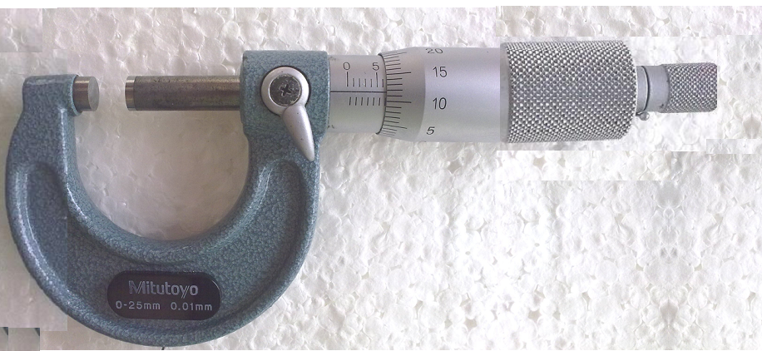







B. The micrometer caliper

Slide 7
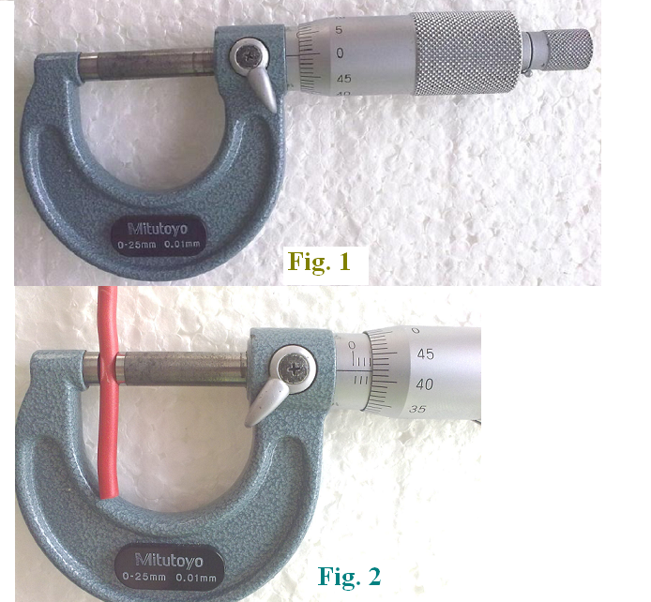


How to use the micrometer
The zero reading of the micrometer.
Before we use the micrometer, it should read zero, the two zero lines must coincide as in fig.1, if not we adjust it.
Measuring the diameter of a wire.
We put the wire between the two jaws, as shown in fig.2 then we turn the movable screw until the two jaws touches the wire, so we hear a tick sound then we stop turning the screw.
After we sure of our measurement, we take the reading of the micrometer which represents the diameter of the wire.

Slide 8

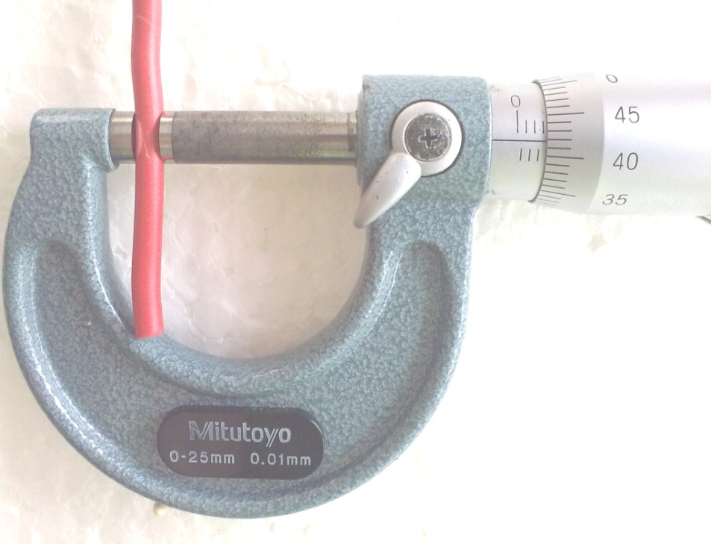

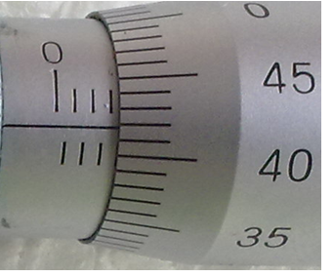
Example :
What is the reading of the micrometer shown in the figure?
Main reading.
We see from the figure that the main reading is 3 mm.
The vernier reading.
We see from the figure that the verier reading is 42 x 0.01 = 0.42 mm.
The final result.
The diameter of the wire is
3 + 0.42 = 3.42 mm .

Slide 9

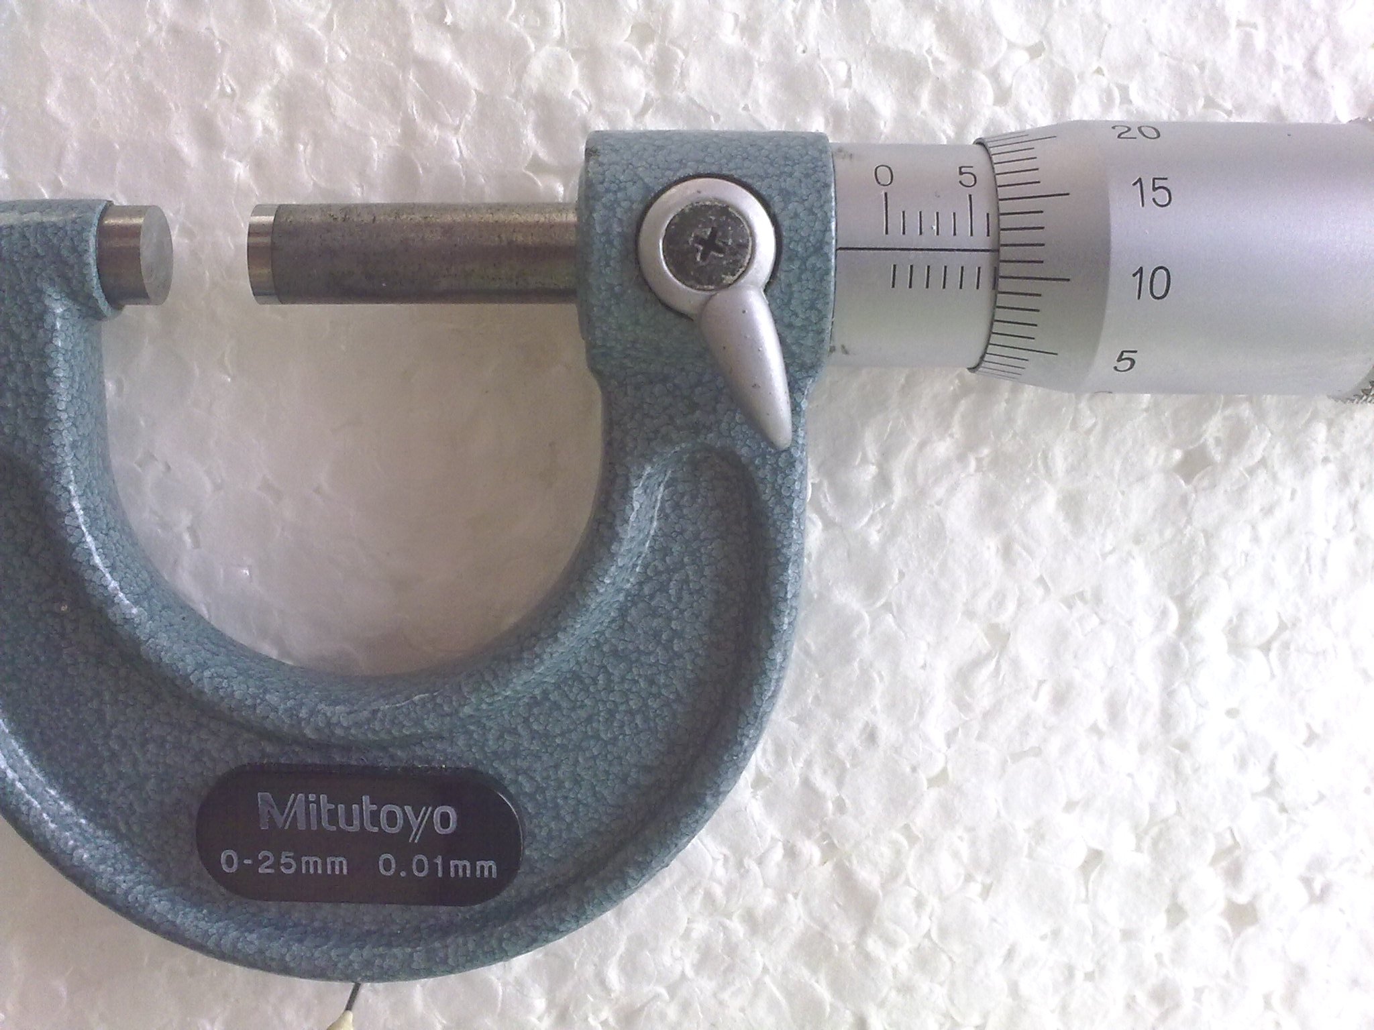

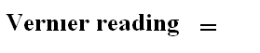
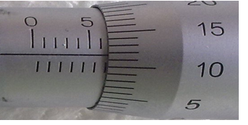

Example :

Slide 10
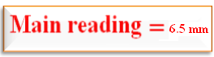
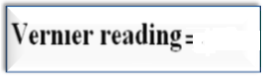
Example :

Slide 11

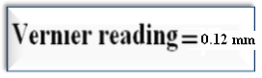
Example :

Slide 12
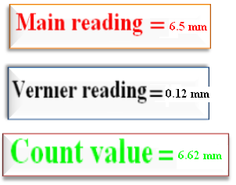
Example :

Slide 13
Basic Measurement I
Objectives:
To be familiar to use the verneir caliper and micrometer caliper
to measure the dimensions of different objects.
Apparatus:
Vernier caliper, micrometer caliper, plastic cylinder, set of different wires.
Results:
A. The vernier Caliper. Sample:
Complete the following table
Table 1 : Diameter of the thin plastic tube
No. | Main Scale mm | Vernier Scale mm | Diameter mm
1 | 6 | 5.5x 2 x 0.05 | 6.55
2 | 6 | 0.55 X

Slide 14
Table 2: Diameter of a Thick Plastic tube
Term |  | Main Scale mm | Vernier Scale Mm | Count Value mm | Mean Value mm
Out side Diameter | 1 | 6 | 7.5 x 2 x0.05 | 6.75
 | 2 | 6 | 0.75 X | 6.75
Inside Diameter | 1 | 6 | 7.5 x 2 x0.05 = 0.75 X | 6.75
 | 2
Length | 1
 | 2

Slide 15
B. The micrometer Caliper.
Complete the following table .
Table 3. Diameter of different wires
Term |  | Main Scale Mm | Vernier Scale Mm | Diameter Mm | Mean value of diameter Mm
Thick wire | 1 | 4.5 | 32x 0.01 | 4.82
 | 2 | 4.5 | 0.32 X
Mid wire | 1 | 4.5 | 32x.01 = 0.32 X
 | 2
Thin wire | 1
 | 2

Slide 16
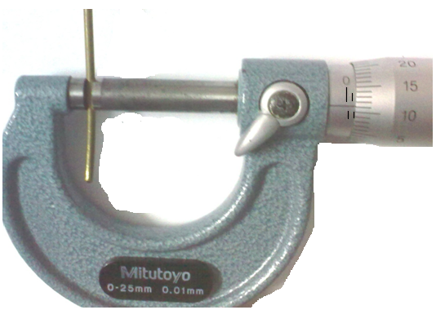
Conclusions:
1. From the results in table 2 what is the inner volume of the cylinder?
_______________________________________________________________________
2. From the results in table 3, what is the radius of the thin wire?
______________________________________________________________________
Questions:
a) From the fig. below, write the reading of the micrometer.
Main reading (mm) | Vernier reading ( mm ) | Total reading ( mm )

